Slide 1
The ARC Community Greenspace
Site Preparation 2020

Slide 2
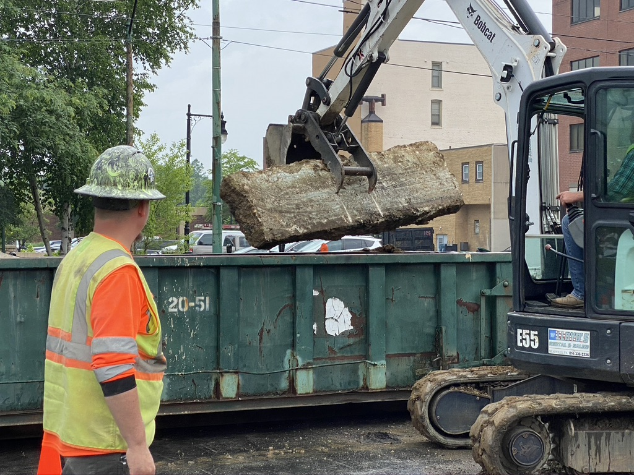
Concrete and Rock-rubble Removal

Slide 3
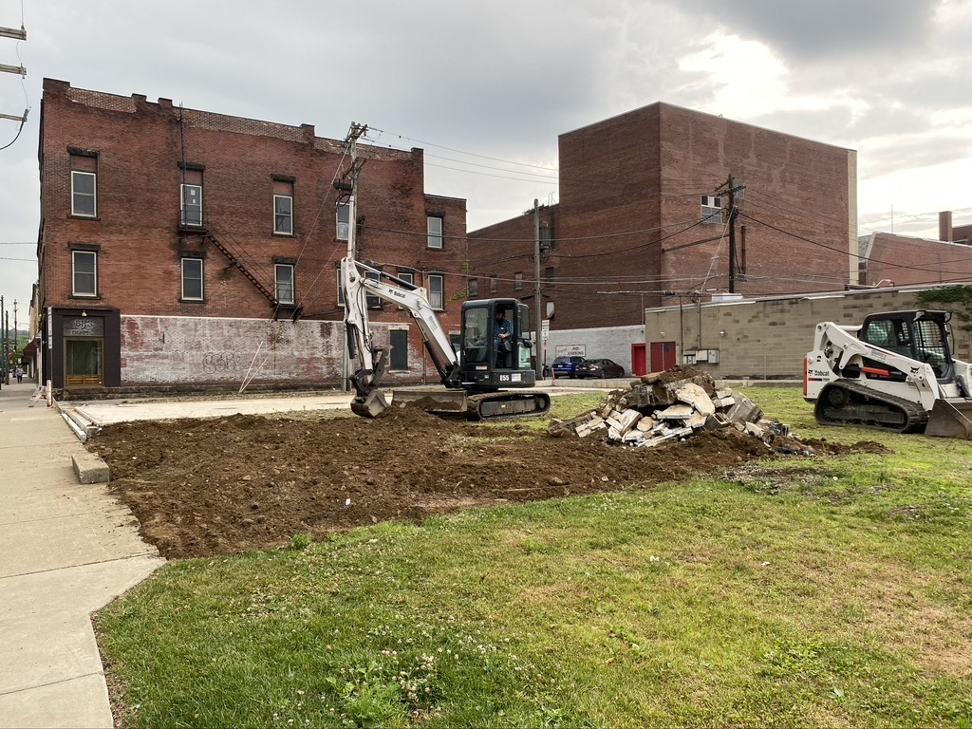
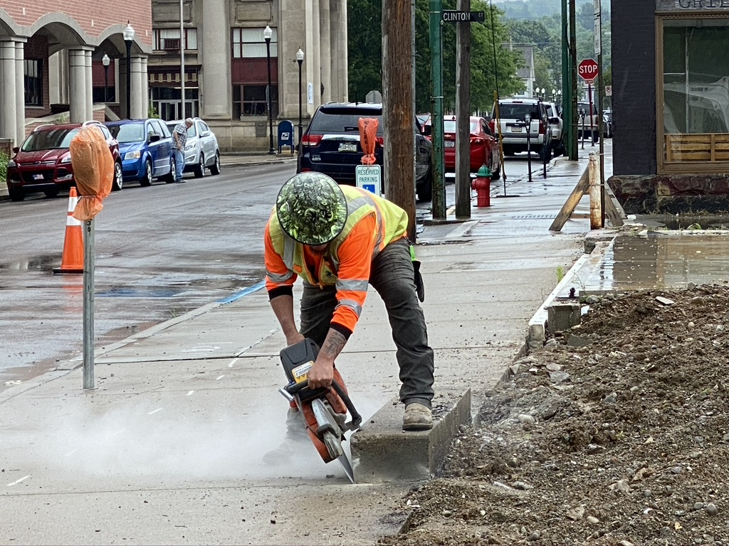
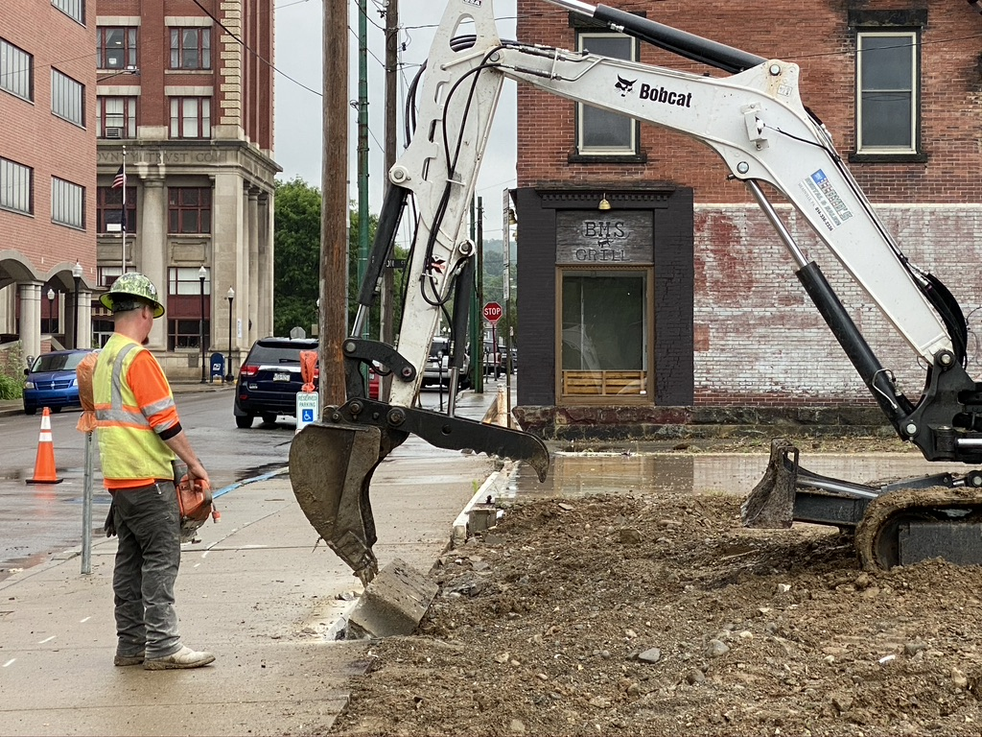
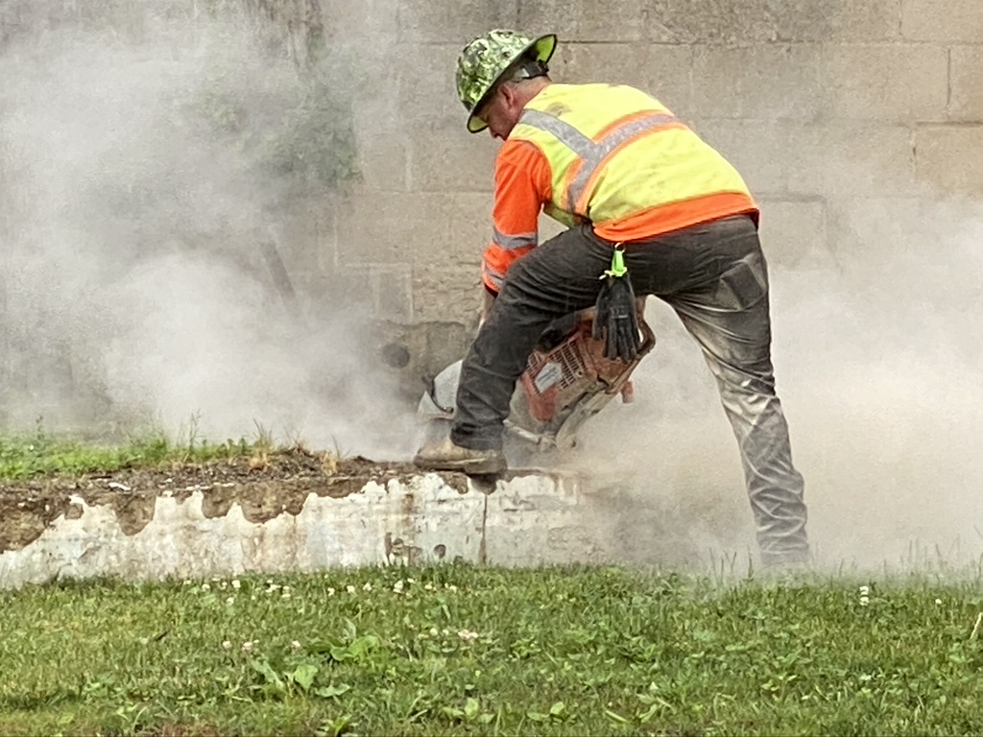
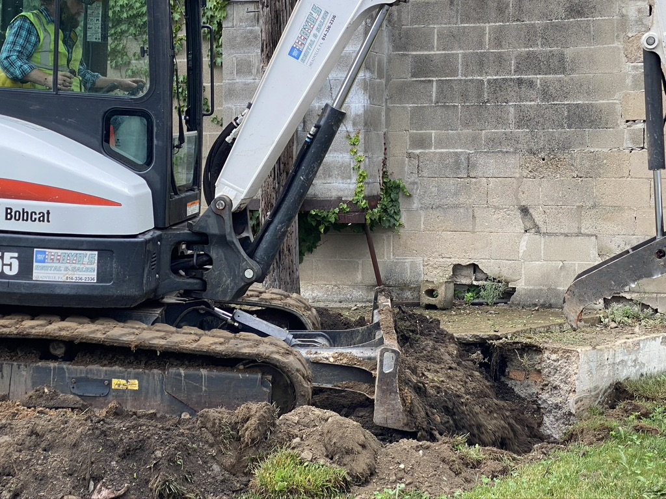

Slide 4
Topsoil Spread
Site Leveled
Ready for Hydroseeding

Slide 5
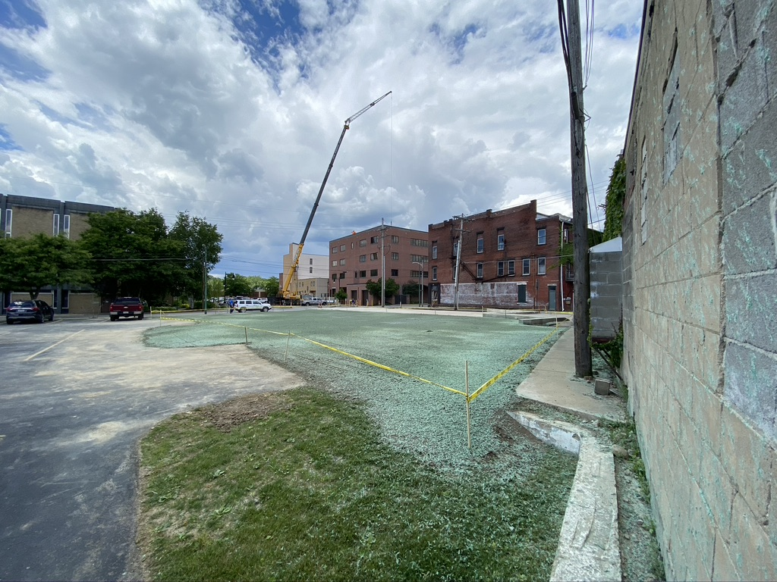
Hydroseeding

Slide 6
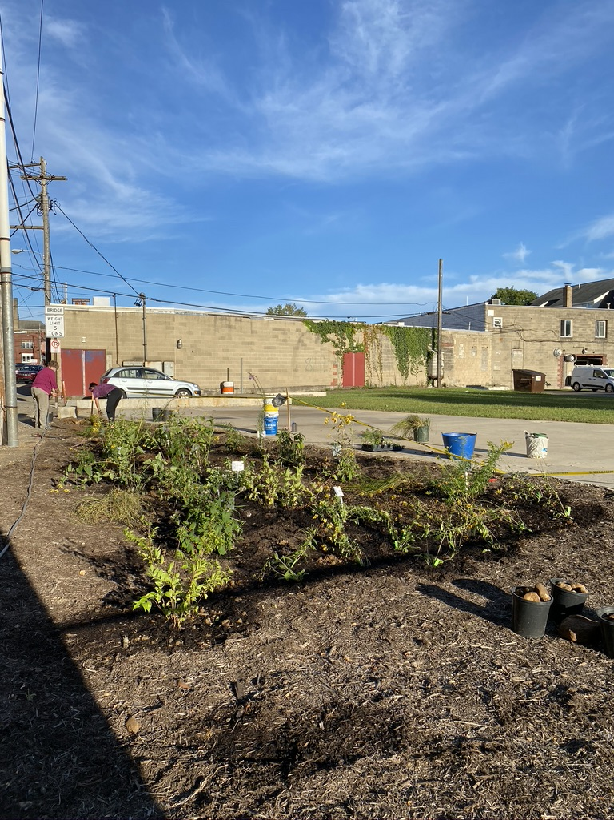
Start of Small Rain Garden Flowers donated by Ernst Conservation Seeds Planted with community volunteers!

Slide 7
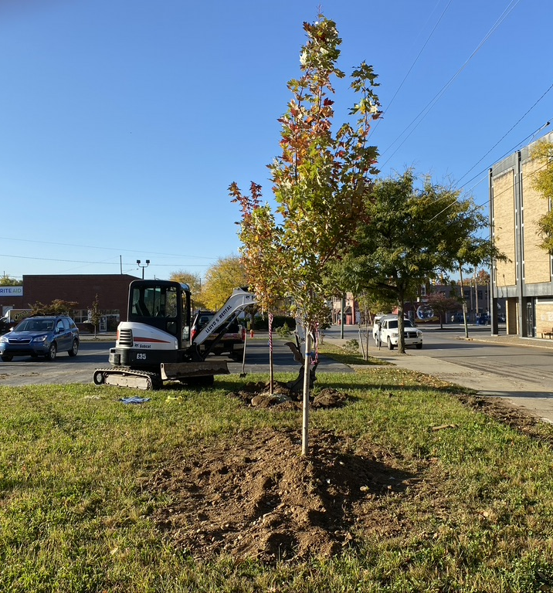
Tree Planting

Slide 9
Tad-dah!!! Ready for Winter & Next Steps Spring 2021 (Note: Snodgrass Mural in top image Installation Mural can be viewed on the Art & Environment Facebook page and on Meadville Calendar)

